Slide 1

Thundercat
Doug Cook

Slide 2
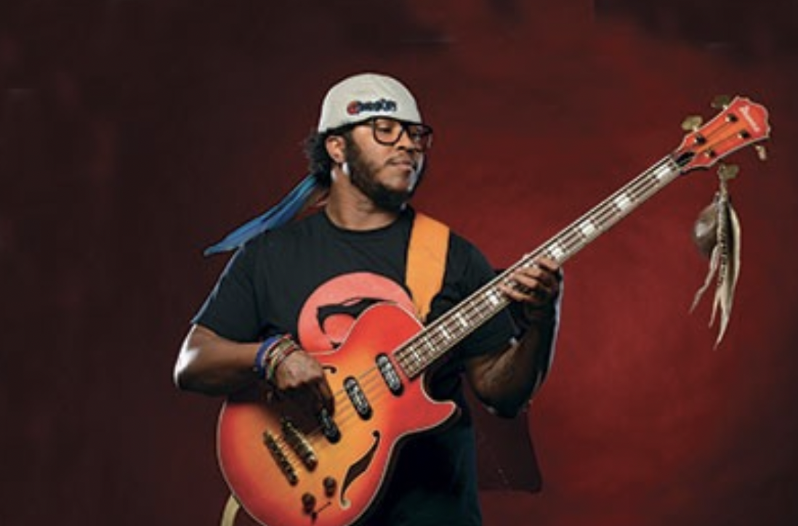
Roots
Started playing at age 4
Father was drummer for The Temptations
Practiced to the Ninja Turtles theme
Minor hit in Germany at age 15 with a boy band called “No Curfew”
Joined Suicidal Tendencies at 16.

Slide 3
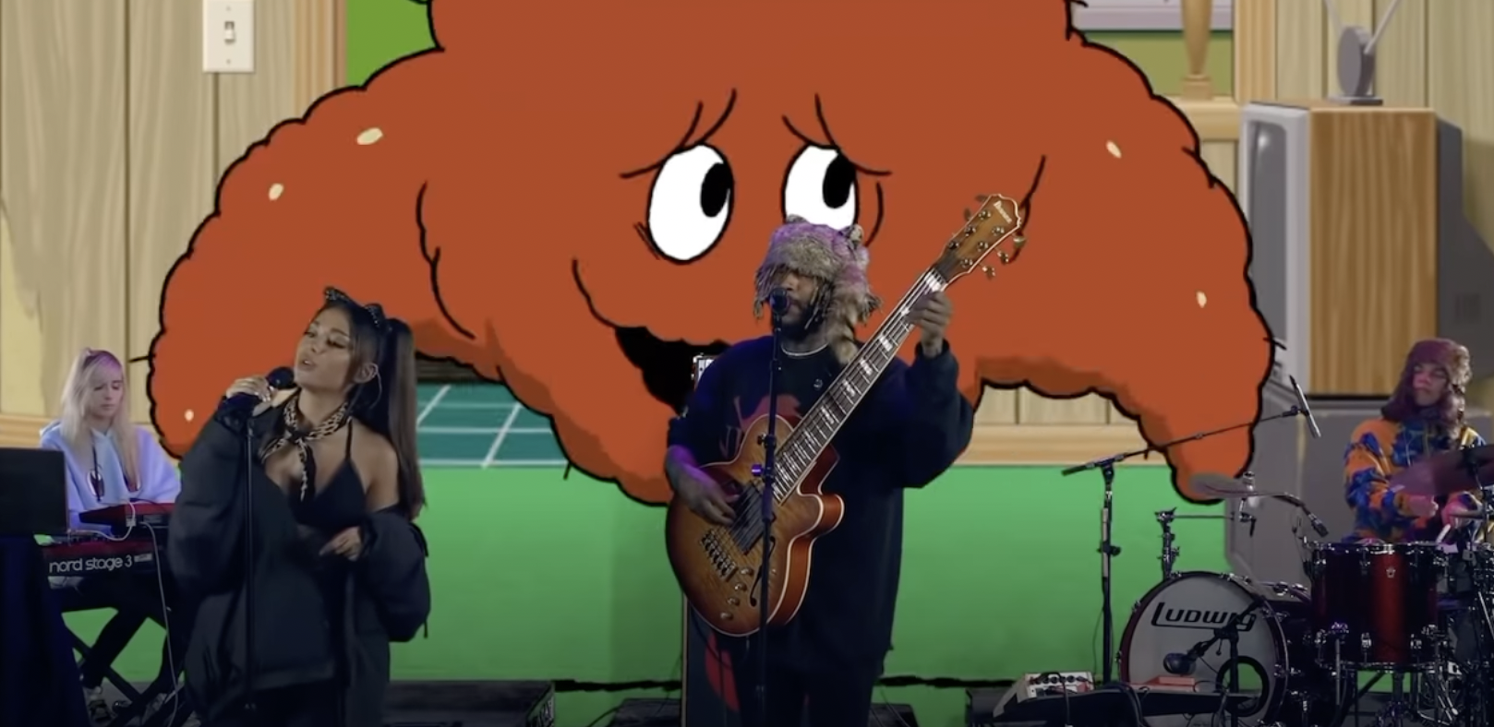
Important collabs
Played on Flying Lotus’s album “Cosmogramma” (2010)
He is said to have been “at the creative epicenter” in the creation of Kendrick Lamar’s “To Pimp a Butterfly” (2015).
Legendary Tiny Desk Concert with Mac Miller
Adult Swim Festival Ariana Grande Collab

Slide 4
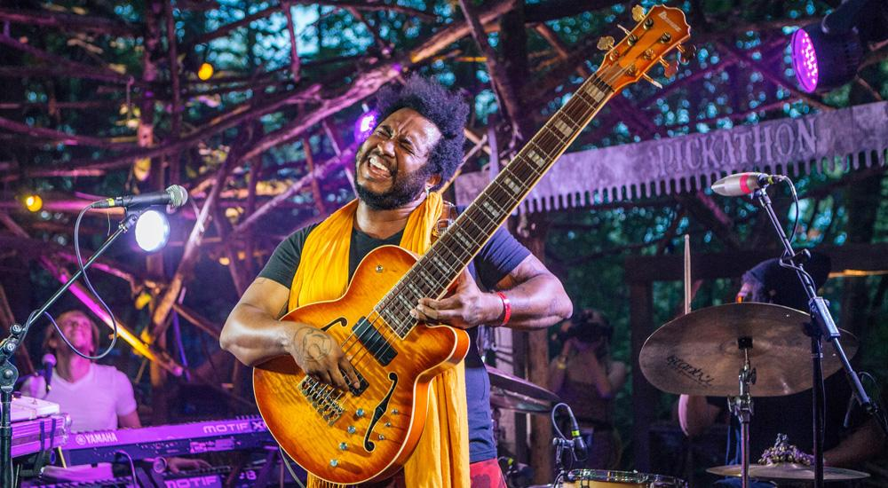
His most important contribution (IMO)
Thundercat’s bass guitars are strikingly innovative!
They features Graph Tech Piezo Saddles
The Piezos send MIDI data
Allows him to add synthesizer doubling of his bass lines, even in live situations.
Buyer Beware!

Slide 5
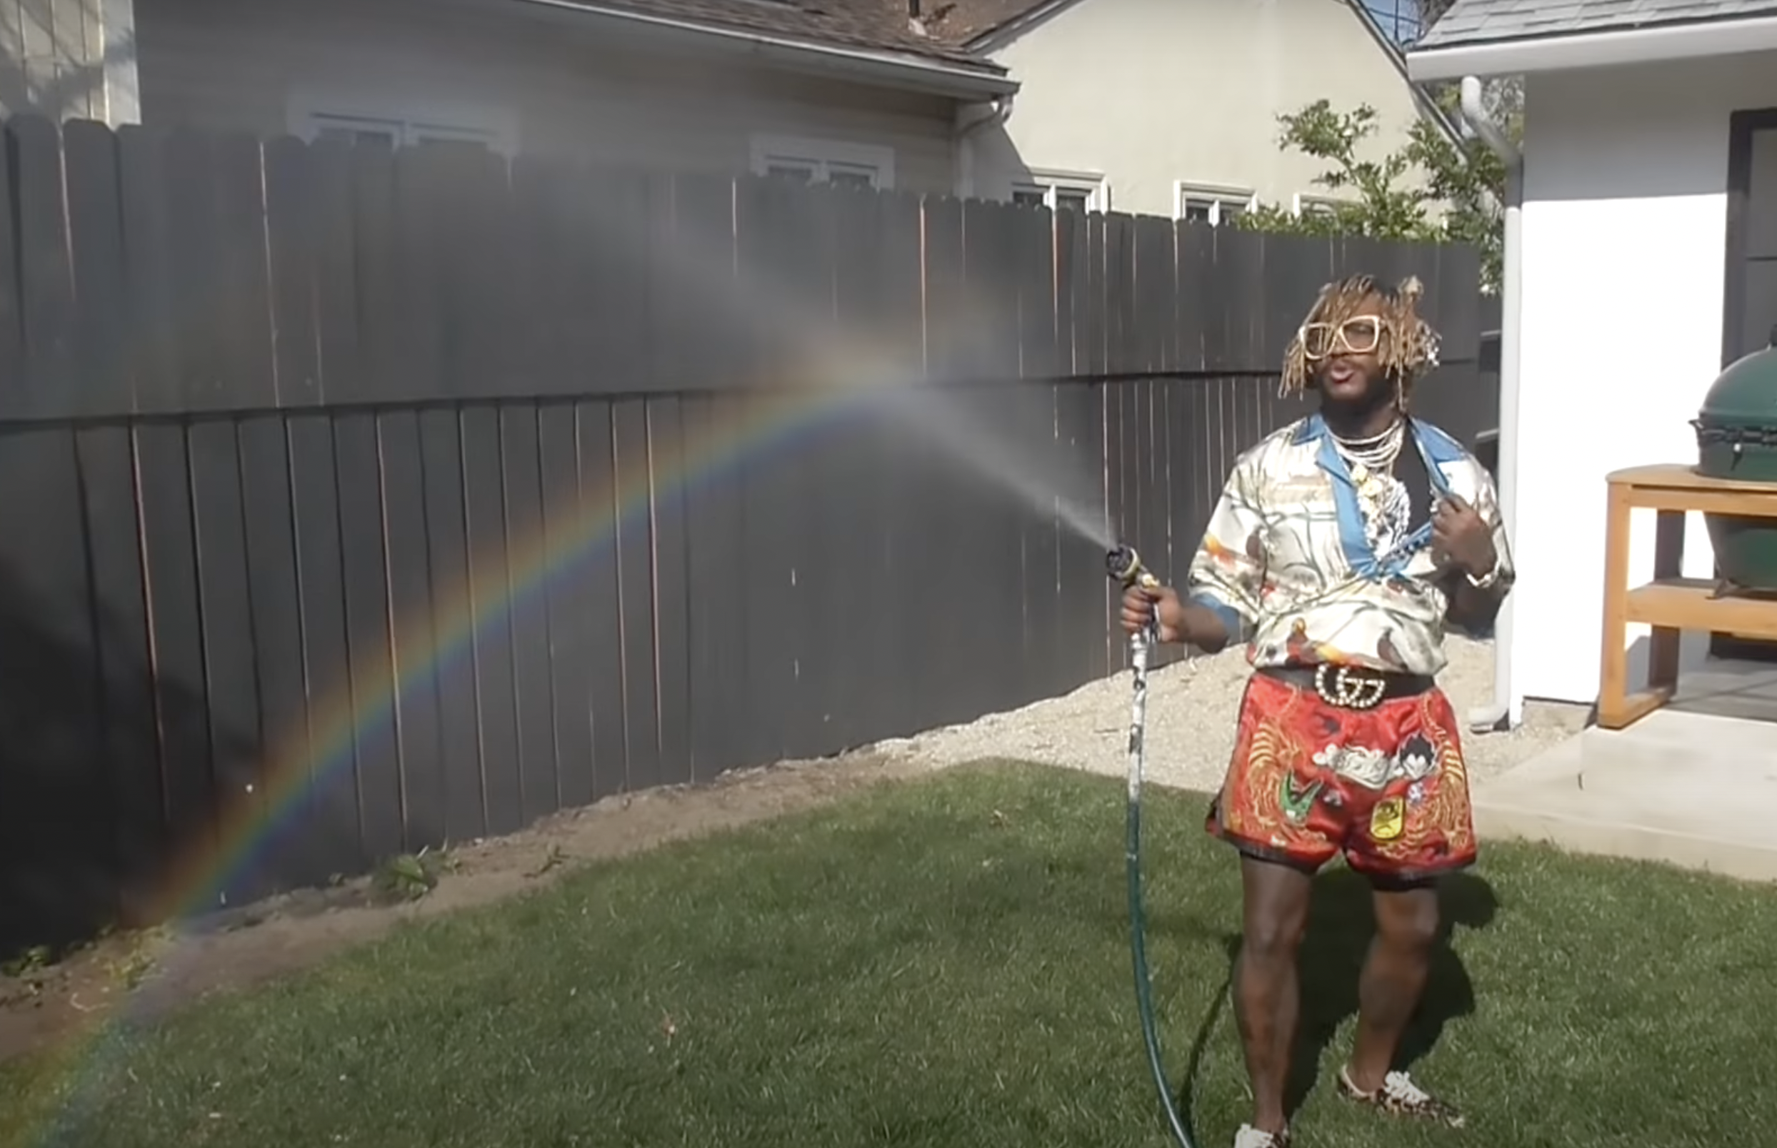
Sources
Mixdown. “Gear Rundown: Thundercat.” Mixdown Magazine, Mixdown Magazine, 8 June 2021, https://mixdownmag.com.au/features/gear-rundown-thundercat/.
On Wikipedia, Ema Nekaf. “Thundercat (Musician).” Wikipedia, Wikimedia Foundation, 12 Apr. 2022, https://en.wikipedia.org/wiki/Thundercat_(musician).
Thundercat. “The Amazing Thundercat.” The Amazing Thundercat | It Is What It Is - out Now, Thundercat, 20 Apr. 2009, http://www.theamazingthundercat.com/.

